Slide 1
PRACTICAL-3 EXCRETORY SYSTEM

Slide 2
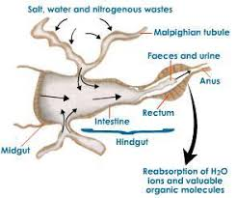
EXCRETORY SYSTEM OF COCKROACH

Slide 3
STRUCTURE AND FUNCTIONS OF EXCRETORY SYSTEM
Different types and their functional mechanisms.
The removal of waste products of metabolism, especially nitrogenous compounds from the body of insects is known as excretion. The excretion process helps the insect to maintain salt water balance and thereby physiological homeostasis. Following are the excretory organs.
Malpighian tubules Thin, blind-ending tubules, originating near the junction of mid and hindgut, predominantly involved in regulation of salt, water and nitrogenous waste excretion. This structure was discovered by Marcello Malpighi.
Nephrocytes Cells that sieve the haemolmph for products that they metabolize (pericardial cells).
Fat bodies A loose or compact aggregation of cells, mostly trophocytes, suspended in the haemocoel, responsible for storage and excretion.
Oenocytes The cells of haemocoel, epidermis or fat body with many functions.
Integument The outer covering of the living tissues of an insect.
Tracheal system The insect gas exchange system, comprising tracheae and tracheoles.
Rectum The posterior part of hind gut. Among the above organs, malpighian tubules are the major organ of excretion.

Slide 4
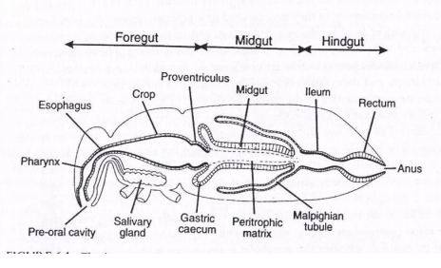

Slide 5
EXCRETORY SYSTEM OF HUMAN

